Slide 1

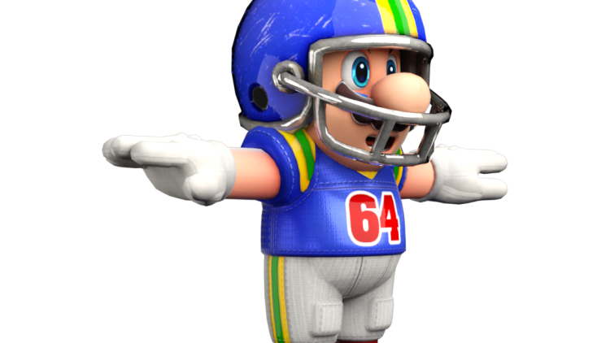

Football II
Produced by Dr. Mario | UNC STOR 538

Slide 2
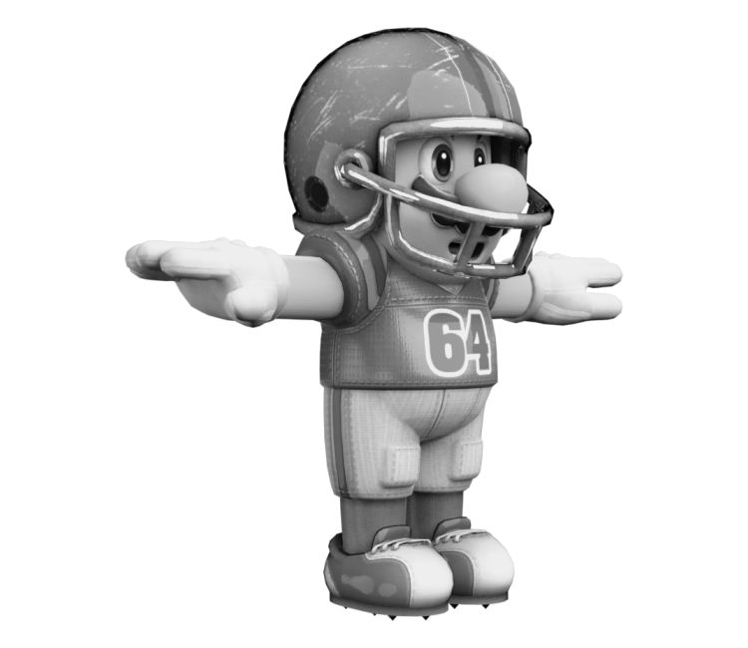
Importance of the Quarterback
Historically Important for Success in NFL
Owner
Establish Team Identity
Hire Leadership
Provide Resources
General Manager
Evaluate Players
Make Trades and Acquire Players
Final Say on Personnel (20/32 Teams)
Coach
Responsible for Player Development
Responsible for On-Field Strategy
Real-Time Game Decisions
Quarterback
Throws the Rock
Highest Paid Position

Slide 3
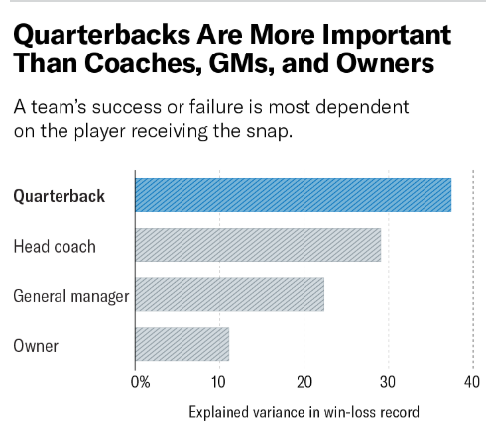
Importance of the Quarterback
We Know All Are Important #Browns
What is the Most Important?
Analysis Published in Harvard Business Review
38 Years of Data
Basic Linear Regression (RSQ=0.682)
Order of Importance by Percentage of RSQ
Comparison of 80s and 90s
Head Coach Effect Unchanged
Owner and General Manager Effects Declined
Value of QB has increased

Slide 4
Metrics for Quarterbacks
Article from Bleacher Report
Passing YDS (Bad Metric to Measure Success)
TD/INT (Accounts for Most Important Info)
COMP/ATT (Misleading)
YDS/ATT (Leaves Out Sacks and Touchdowns)
Passer Rating (Accounts for Most QB Information)
Dates Back to 1971 and Hasn’t Changed
Minimum = 0 & Maximum = 158.3
Leader in 2018 Was Danny Amendola
QBR (Produced by ESPN)
Created in 2011
Minimum = 0 & Maximum = 100
Compares Outcome to Expected Outcome
Leaders in 2018 Were Patrick Mahomes and Drew Brees
W/G (Classic Problem Similar to Baseball Pitching)
YDS = Yards
TD = Touchdown
INT = Interception
COMP = Completion
ATT = Attempts
W = Wins
G = Games

Slide 5
Metrics for Quarterbacks
Advanced Stats from Football Outsiders
Defense-Adjusted Value Over Average (DVOA)
Defense-Adjusted Yards Over Replacement (DYOA)
Advanced Stats from Brian Burke (Advanced
Football Analytics)
Win Probability Added (WPA)
Expected Points Added (EPA)
YDS = Yards
TD = Touchdown
INT = Interception
ATT = Attempts
SYDS=Sack Yards
S=Sacks

Slide 6
Tom Brady VS Aaron Rodgers
Quarterback’s Rating Based on 4 Stats (NFL)
Comp/ATT
YDS/ATT
INT/ATT
TD/ATT
Critique: “Any system for rating quarterbacks based on passing statistics is really rating the team’s entire passing game."
Estimated Linear Model for Wins
Conducted by Brian Burke (ESPN)
Data from 2002-2006
Created Total QBR for ESPN in 2016
YDS = Yards
TD = Touchdown
INT = Interception
COMP = Completion
ATT = Attempts

Slide 7
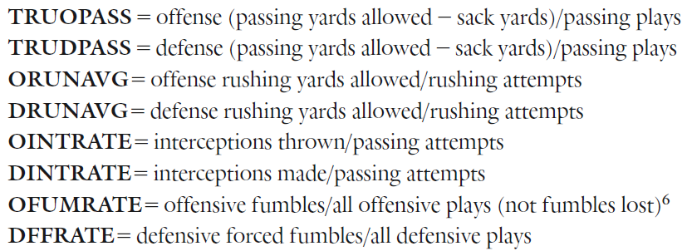
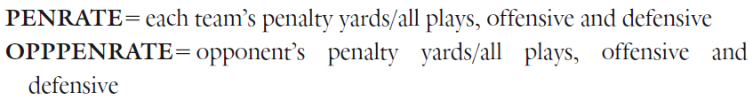
Tom Brady VS Aaron Rodgers
Independent Variables for Wins

Slide 8
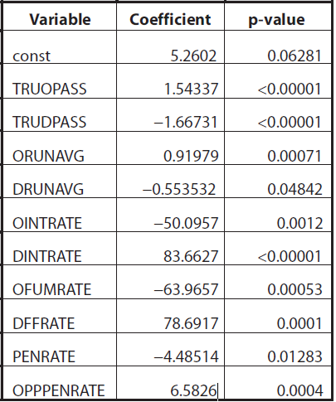
Tom Brady VS Aaron Rodgers
Results of Regression
All Passing Information

Slide 9
Tom Brady VS Aaron Rodgers
Results of Regression
Contribution from Offense QB
$$QBR \left(Book\right)=1.543\left(TRUOPASS\right)−50.096(OINTRATE)$$

Slide 10
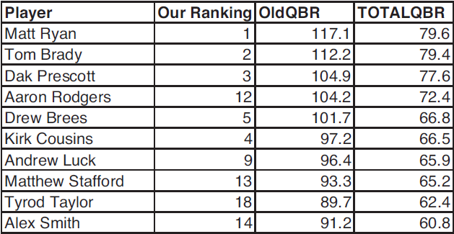
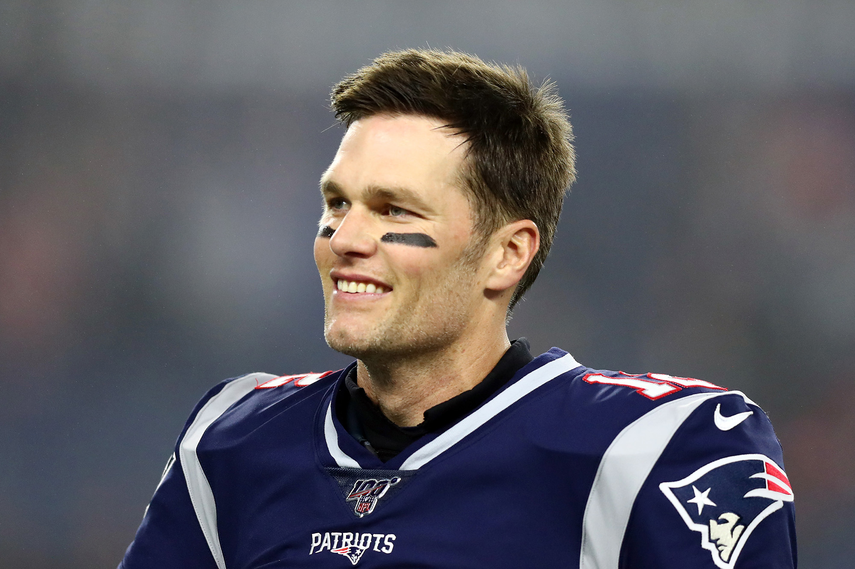
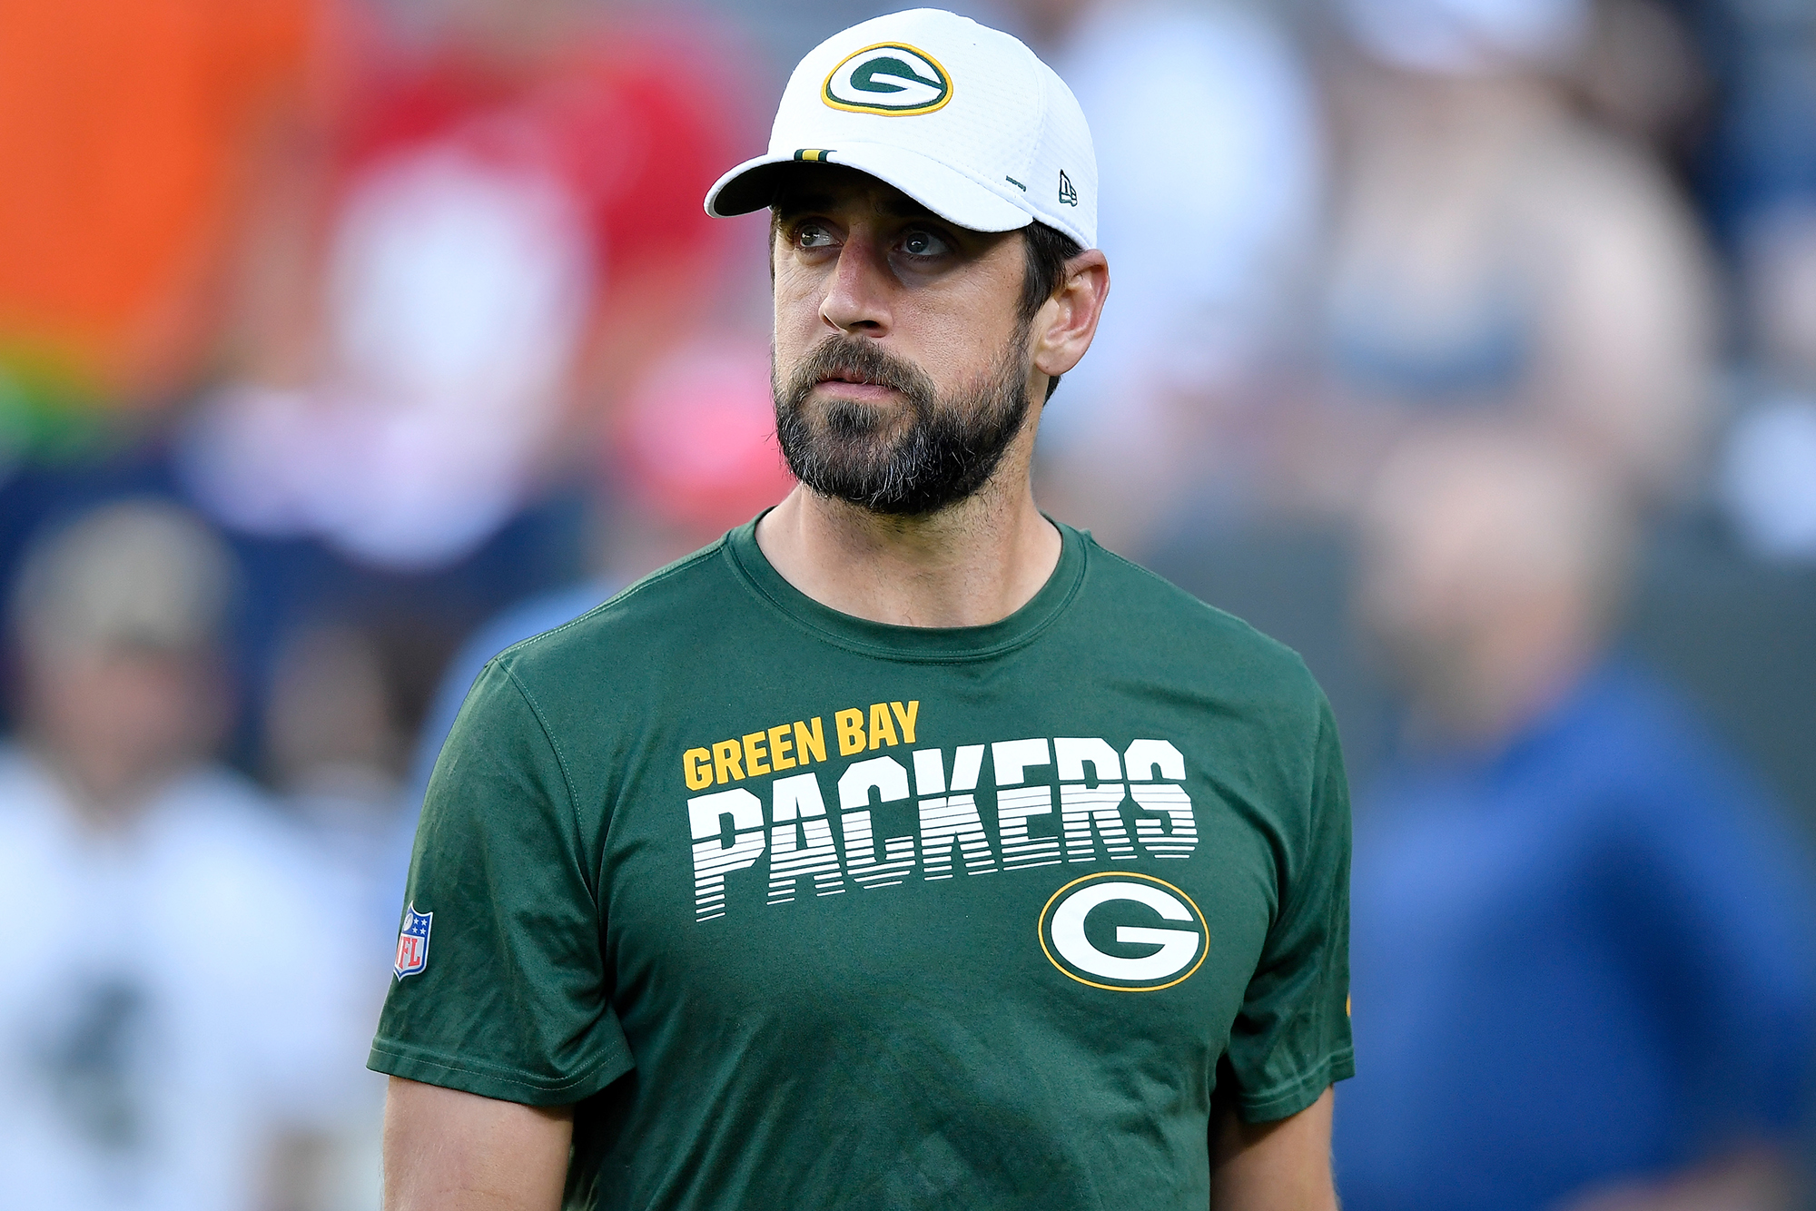
Tom Brady VS Aaron Rodgers
Comparing Ratings in 2016

Slide 11
Tom Brady VS Aaron Rodgers
Correlation Between Ratings
Book with QBR (0.9)
Book with Total QBR (0.82)
Further Adjustment Needed to Measure the Quality of the Quarterback?
Book Points Out the Difficulty in Understanding How the Offensive Line Contributes to the QB’s Success

Slide 12

Final Inspiration
All I know is grind.
- Reverend Ray Lewis

